Slide 1


Lead Scoring Case Study Using Machine Learning
Submitted By:
Jyoti Tiwari 12103629

Slide 2
Content
1- Certificates
2- Introduction 3- Define Topic 4- Problem Statement 5- Solution Methodology 6- EDA 7- Building Model 8- Features 9- Curves
10- Cutoof Point 11- Description Of The Problem 12- Future Scope

Slide 3
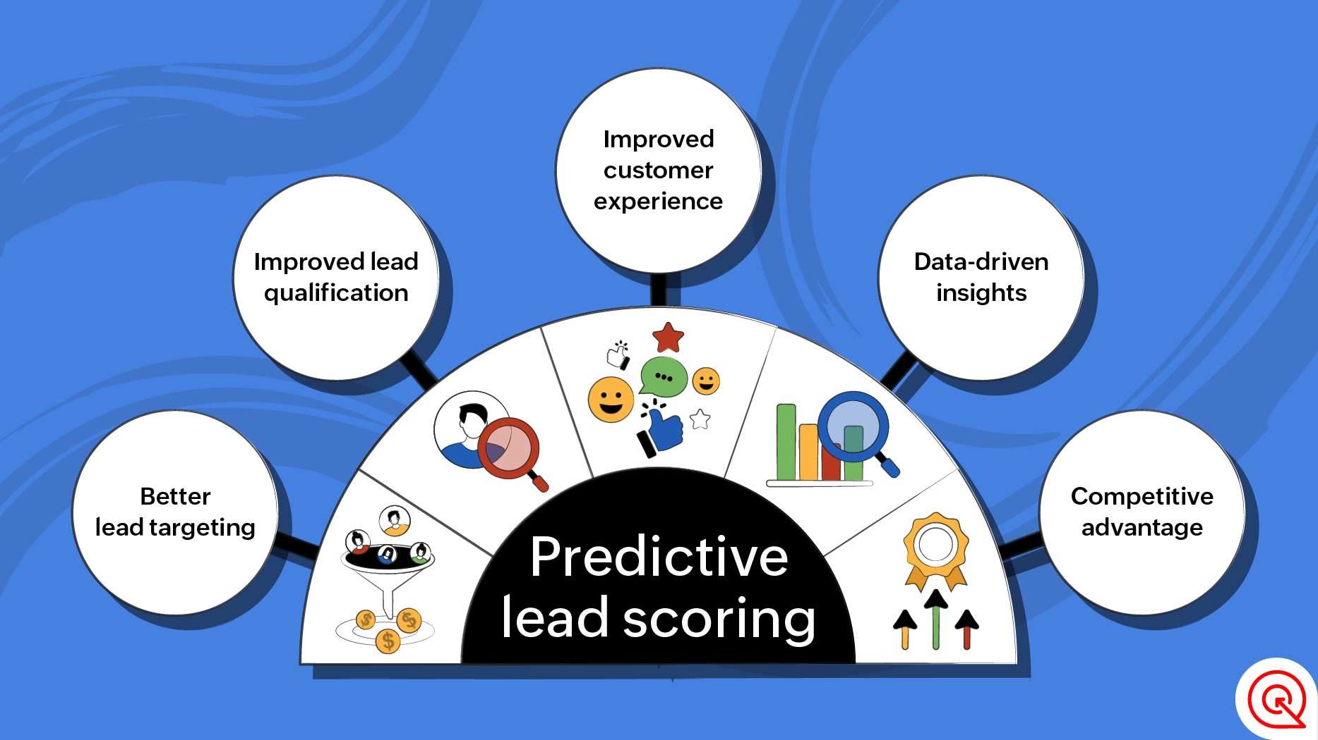
Introduction
In an increasingly competitive business landscape, lead scoring has become a critical component of sales and marketing strategies. By accurately identifying high-quality leads, organizations can optimize their efforts and resources, leading to more efficient and effective sales campaigns.
This case study explores how the integration of machine learning techniques can revolutionize the lead scoring process, providing data-driven insights and enhanced predictive capabilities.

Slide 4
What is Lead Scoring
Purpose It enables educational
institutions to discover
and prioritize possible
leads based on their
chance of Converting
into students or
customers.
Definition
Lead Scoring ranks
prospects on a scale
based on their
perceived worth to the organization.
Advantages Efficient resource
allocation,
higher conversation rates,
and personalized
communication
tactics. It also allows us
to better understand the
marketing teams' strategy
for different lead
categories, resulting in
more focused
and effective campaigns.

Slide 5
Problem Statement
This company is selling online educational materials to professionals in the industry.
Despite receiving a high volume of leads, X Education’s conversion rate is low. For example, if they generate 100 leads in a day, only around 30 of them will convert.
To improve efficiency, the organization aims to discover high-potential leads, or 'Hot Leads’.
Identifying these leads can increase lead conversion rates since the sales staff can focus on connecting with them instead of calling everyone.

Slide 6
Solution Methodology
Data Manipulation
Data Cleaning
Data Importing and Inspection
Import dataset from Kaggle.
If any data has any missing values need data conversions.
Total number of rows 37, Total number of Columns 9240.
Imputation of the values, if necessary
It will do the data modify.
If large number of missing values are not in use it drop the columns.
It check and repair the outliers in data.

Slide 7
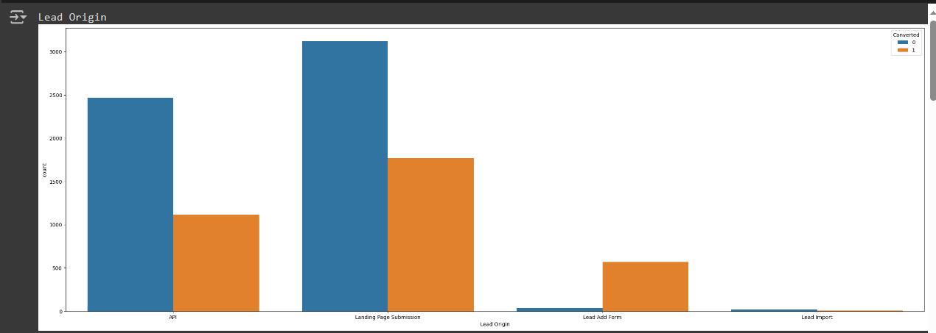
EDA ( Exploratory Data Analysis)
Data scientists use it to study and explore data sets, as well
as describe their key properties, and they frequently
use data visualization approaches.

Slide 8
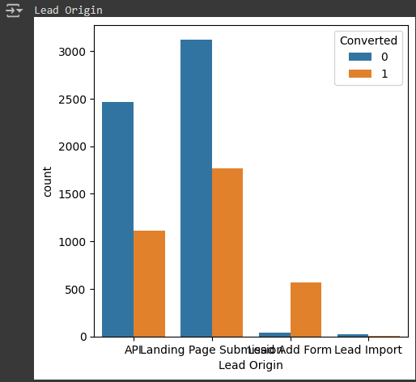
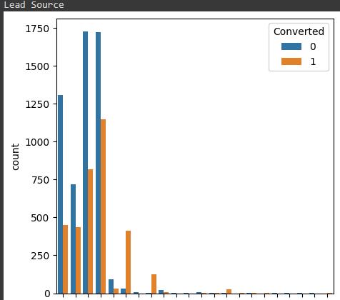
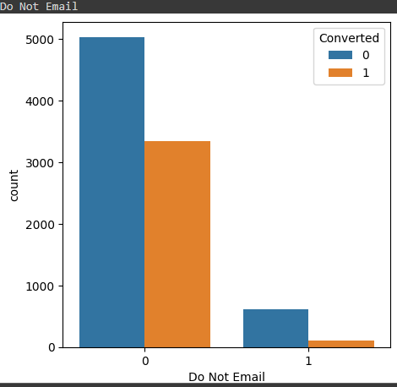
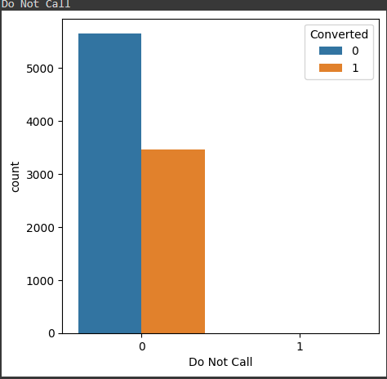

Slide 9
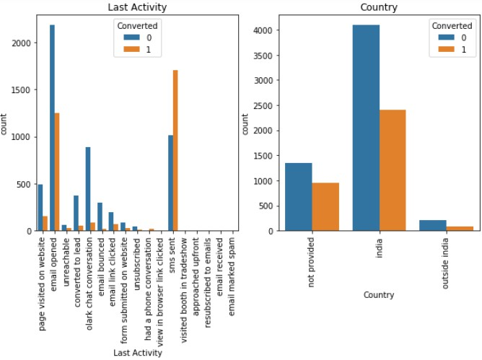

Slide 10
Building Machine Learning Models
The initial stage in regression is to separate the data into training and
testing sets, using a 70:30 ratio.
Apply RFE for feature selection.
Run RFE with 15 variables as output.
Build model by deleting variables with p-value > 0.05 and vif > 5.
Made predictions on test data set with 81% accuracy.

Slide 11
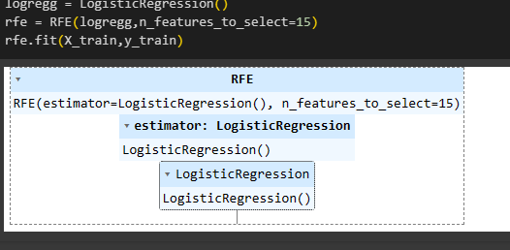
RFE (Recursive Feature Elimination)
It is used for feature selection Technique and identify most important feature in dataset.
It works recursively and convert categorical data to the binary (0-1).

Slide 12
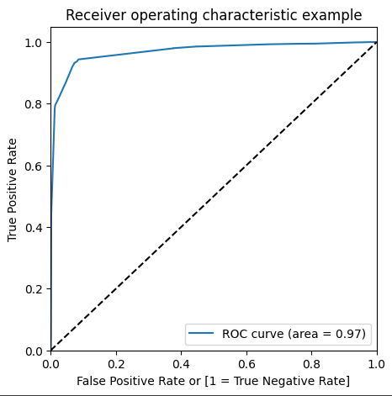
ROC (Receiver Operating Characteristic Curve)
Sensitivity and Specificity evaluating in mode.
This helps us with representing the visuals and finding optimal cut off point.

Slide 13
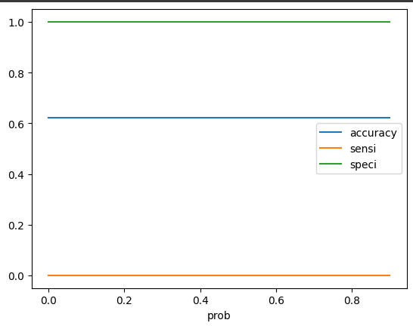
Cutoof Point
It refers to the threshold values of
classifiers output.
It ensuring accurate positive identification while minimizing false positives.
This technique maintains sensitivity by precisely detecting true positive cases, crucial for reducing false positives in classification..

Slide 14
Description Of The Problem
The firm sells online educational courses to industry experts and requires a methodology for assigning lead scores to site visitors.
These lead scores will distinguish potential clients based on their probability to convert, with higher scores suggesting a better possibility of conversion.
Management has set a goal lead conversion rate of about 80% for this activity.
The aim is to properly anticipate customer conversion probabilities, allowing for optimal resource allocation to optimize conversion rates.

Slide 15
Future Scope
Promote data-driven decision-making to maximize lead scoring benefits and
inspire innovative sales and marketing strategies.
Prioritize continuous improvement to maximize the lead scoring system’s
influence on sales performance and company growth.
Future study should look into advanced machine learning approaches such as
ensemble methods and data resampling to increase model accuracy.
Consider the generalizability of lead scoring models across domains to ensure
dependability.
Compare lead scoring models to cutting-edge approaches and various datasets
to ensure efficacy.

Slide 16
THANK YOU

